Slide 1
MERVL-int
MTA_Mm
BGLII
MTC-int
MTA_Mm-int
MTC
MTD
Notes:
M-A plot for H3K4me3 chip-seq experiment at occyte stage. RT families with extreme z-score ( abs(z-score) >= 20 ) are colored by red.

Slide 2
MT2_Mm
ORR1A0-int
ORR1A-int
MERVL-int
MT2C_Mm
Notes:
M-A plot for H3K4me3 chip-seq experiment at 2cell stage. RT families with extreme z-score ( abs(z-score) >= 20 ) are colored by red.

Slide 3
MT2C_Mm
MT2_Mm
IAPLTR1_Mm
MT2B2
RLTR45-int
Notes:
M-A plot for H3K4me3 chip-seq experiment at 4cell stage. RT families with extreme z-score ( abs(z-score) >= 20 ) are colored by red.

Slide 4
RLTR13B2
RLTR13C2
ERVB4_2-LTR_MM
RLTR45-int
MMETn-int
IPAEz-int
Notes:
M-A plot for H3K4me3 chip-seq experiment at 8cell stage. RT families with extreme z-score ( abs(z-score) >= 20 ) are colored by red.

Slide 5
ERVB4_2-LTR_MM
RLTR1B
RLTR13B1
RLTR45-int
RLTR45
Notes:
M-A plot for H3K4me3 chip-seq experiment at morual stage. RT families with extreme z-score ( abs(z-score) >= 20 ) are colored by red.

Slide 6
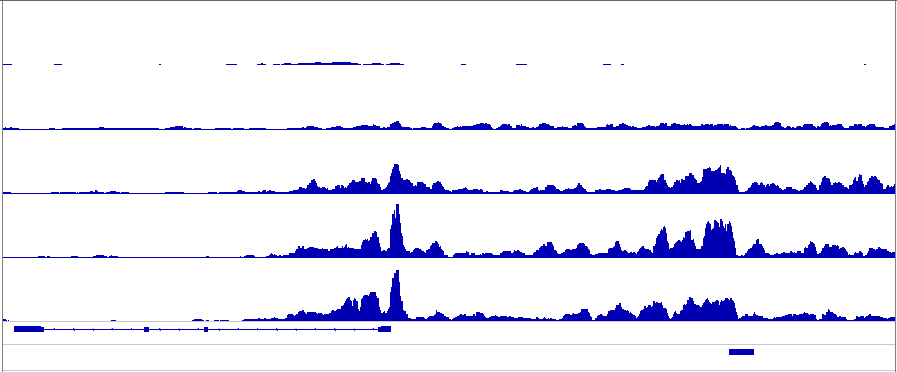
50
OOCYTE
0
50
2C
0
50
4C
0
50
8C
0
50
MORULA
0
CDK2AP1
MT2B2
Notes:
IGV snapshot of H3K4me3 profile around gene CDK2AP1

Slide 7
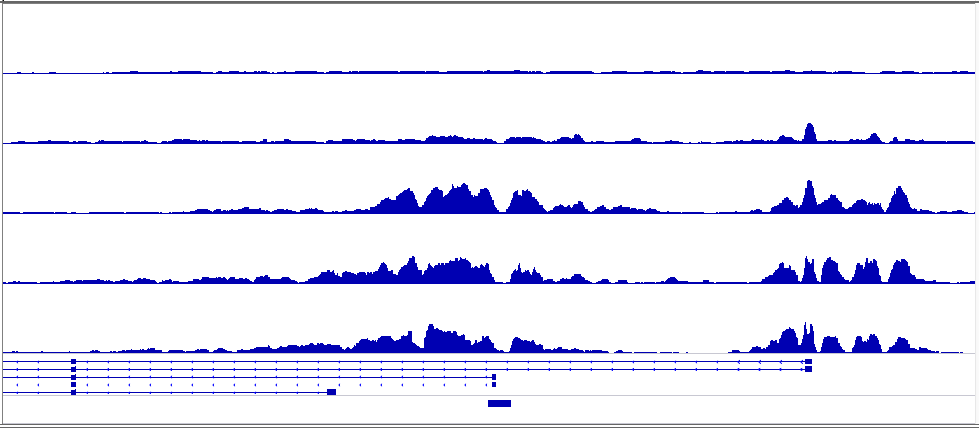
50
OOCYTE
0
50
2C
0
50
4C
0
50
8C
0
50
MORULA
0
PEMT
MT2_Mm
Notes:
IGV snapshot of H3K4me3 profile around gene PEMT

Slide 8
-1.5
-1
-0.5
0
0.5
1
1.5
Notes:
Heatmap of H3K4me3 enrichment profile for the 70 RT families which show most dynamic modification level across 5 stages.

Slide 9
Notes:
The M-A plot of 8cell stage chip-seq experiment before (left) and after (right) normalization. The red line is the fitted M-A trend by lowess.

Slide 10
Please ignore all figures after this slide
Notes:
PEMPT

